Slide 1
1W AstraMini Compact Design COB Light with 1 inch Cutout

Slide 2
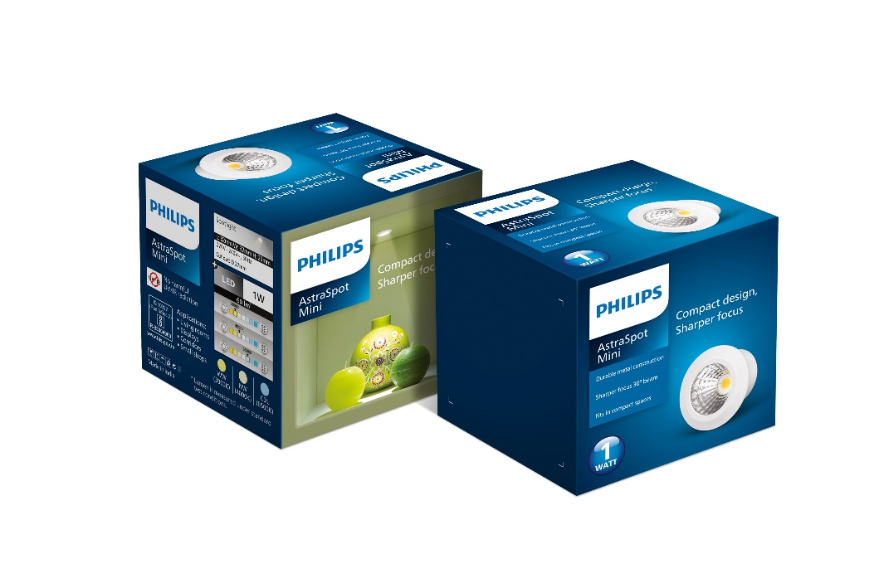
1W AstraMini
Premium COB Light for smaller spaces
Metal housing for longer life
COB light source with reflector for extra sharp light beam
1 Inch Cutout for easy fit into small spaces along with 1 inch conduit pipes
Focused 30 Degree Beam Angle
Sleek design with slim trim
External driver
Super robust construction - Premium white aluminum housing
Wide voltage protection from 160V – 360V and surge up to 2KV
No harmful UV radiation

Slide 3
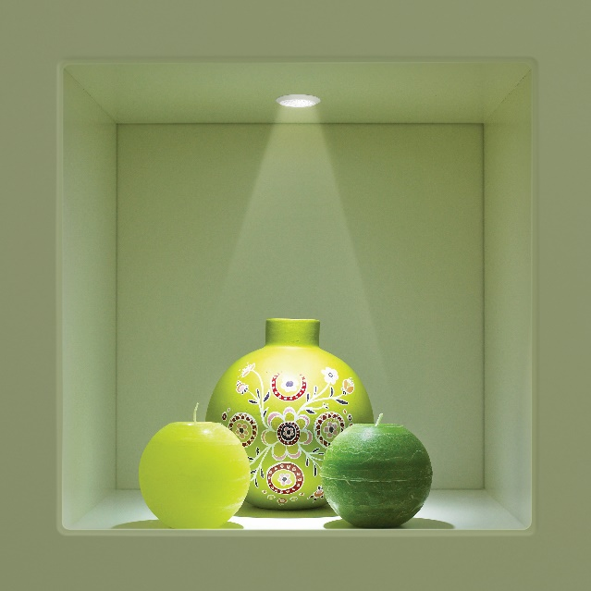
AstraMini– 1W
LED COB 1W Round
Essential
20000 Hrs Life
Strong focused beam
Wide voltage protection (160-360V)
Premium Material – die cast aluminum
General Specs
Application | Spotlight
Color & Material | White & Aluminum
Lamp base & wattage (Color Temperature) | LED 1W, 240V 50Hz 3000K,4000K, 6500
Dimensions (L X W X H)mm | 32 mm (W) x 23 mm (H)
Cut out | 27 mm
Lumen Output | 60 Lm
Master Pack | 30

Slide 4
Commercials
12NC | Description | NSP | DLP | RDP | MRP | Case Lot
929003635601 | 1W AstraMini LED COB (WW) | 106 | 126 | 135 | 250 | 30
929003635701 | 1W AstraMini LED COB (NW) | 106 | 126 | 135 | 250 | 30
929003635801 | 1W AstraMini LED COB (CDL) | 106 | 126 | 135 | 250 | 30

